Slide 1


by
GIRIJA sWAMINATHAN
EMPLOYEE - ATTRITION

Slide 2
OBJECTIVE :
To analyse employee data, uncover key drivers of attrition
Build predictive models to support proactive decision-making in workforce management
Enhance workforce planning

Slide 3
Why it matters?
High Cost : Employee turnover drives up recruitment, onboarding and training expenses
Knowledge Drain : Experienced employees leaving take critical skills and institutional knowledge
Lost Productivity : Departures disrupt teams, delay projects, and reduce overall productivity
“Attrition isn’t just turnover — it’s lost talent, lost time, and lost growth.”

Slide 4
Technical Methodologies Used
Python programming
Data preprocessing
Train-Test split
Model Training
Hyperparameter Tuning
Performance Metrics
Model saving
Streamlit Deployment

Slide 5
DATA OVERVIEW :
INDEPENDENT VARIABLES
Demographics : Age, Gender, Marital status, Over 18
Job _ Related : Department, Job Role, Job Level, Business travel, Distance from home, Years at company
Benefits : Monthly Income, Salary Hike, Stocks
Performances : Rating, work life balance, Job satisfaction, Environment satisfaction
Career & Experiences : Total working years, No of companies worked, Education, Education Fiels
TARGET VARIABLE
Attrition

Slide 6
PREPROCESSING
Checked Missing values, Nan Values, and Duplicates records
Removed irrelevant and unnecessary columns to enhance data quality & model accuracy
Performed outlier detection using KDE plots and addressed outliers through log10 transformation
Split the dataset into training and testing sets using a 70 : 30 ratio
Encoded categorical variables using Label Encoding
Standardized numerical features using StandardScaler
Applied SMOTE to handle class imbalance through oversampling
Ensured the dataset was clean, balanced, and well-prepared for model building

Slide 7
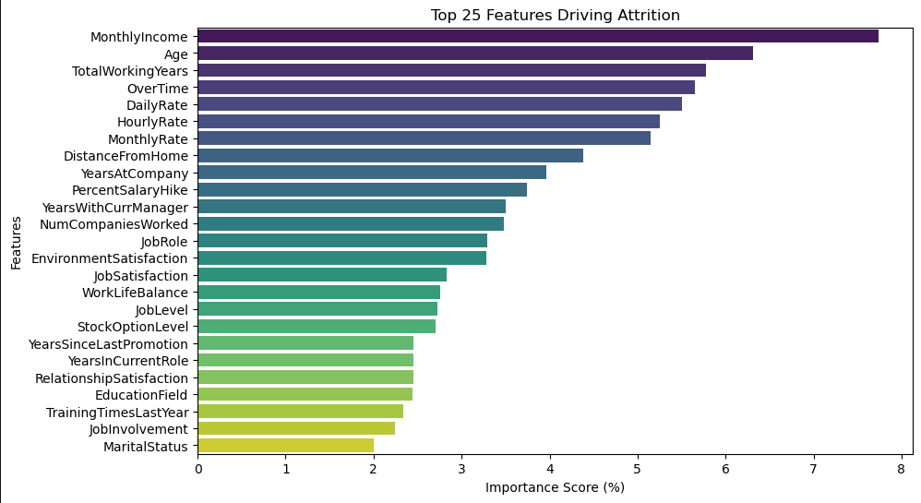
TOP 25 Features Driving Attrition

Slide 8
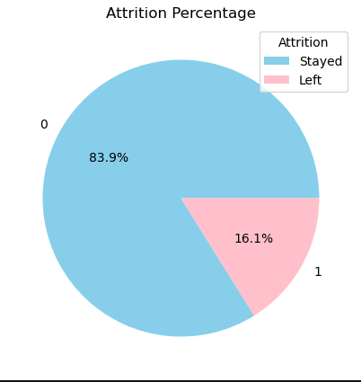
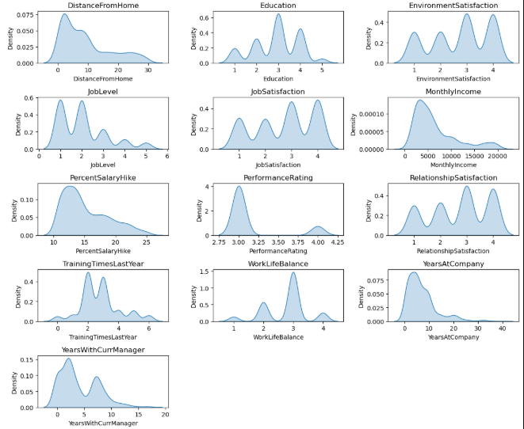
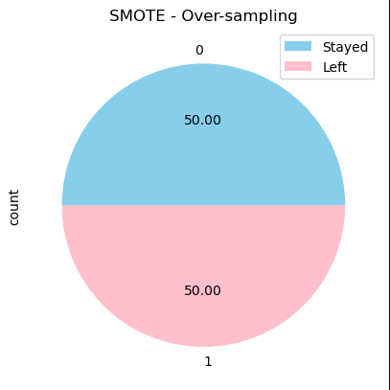
Feature Distribution Analysis :
SMOTE

Slide 9
Model selection, training and performance evaluation
Trained the dataset using eight different machine learning models
Applied GridSearchCV for hyperparameter tuning and identified the best-performing parameters
Optimized model performance by adjusting classification threshold values
Evaluated models using classification reports and standard performance metrics
All models demonstrated strong performance, achieving accuracy above 85% and AUC-ROC scores of 80% or higher

Slide 10
MODEL PERFORMANCE :
MODEL | ACCURACY | PRECISION | F1-SCORE | RECALL | AOU-ROC
LOGISTIC REGRESSION | 0.89 | 0.87 | 0.80 | 0.82 | 0.85
ADA BOOST | 0.89 | 0.88 | 0.89 | 0.89 | 0.84
RANDOM FOREST | 0.83 | 0.85 | 0.87 | 0.84 | 0.81
XG BOOST | 0.88 | 0.87 | 0.88 | 0.85 | 0.81
GRADIENT BOOSTING | 0.89 | 0.85 | 0.87 | 0.85 | 0.80
SVC | 0.84 | 0.87 | 0.83 | 0.84 | 0.78
DECISION TREE | 0.87 | 0.83 | 0.81 | 0.82 | 0.70
K NEIGHBORS | 0.87 | 0.88 | 0.89 | 088 | 0.70

Slide 11
STREAMLIT DEPLOYMENT:
Saved all trained models, optimized hyperparameters, and evaluation metrics using Joblib
Loaded the best performing models into streamlit for deployment
Developed an interactive front – end application to predict employee attrition and performance rating
Enabled real time predictions through a user-friendly streamlit interface

Slide 12
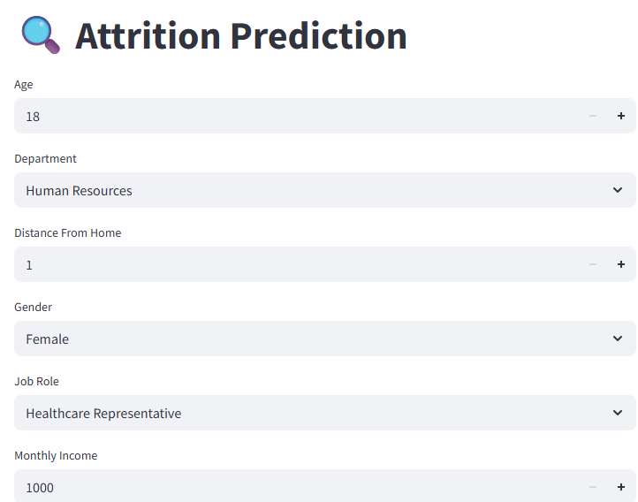
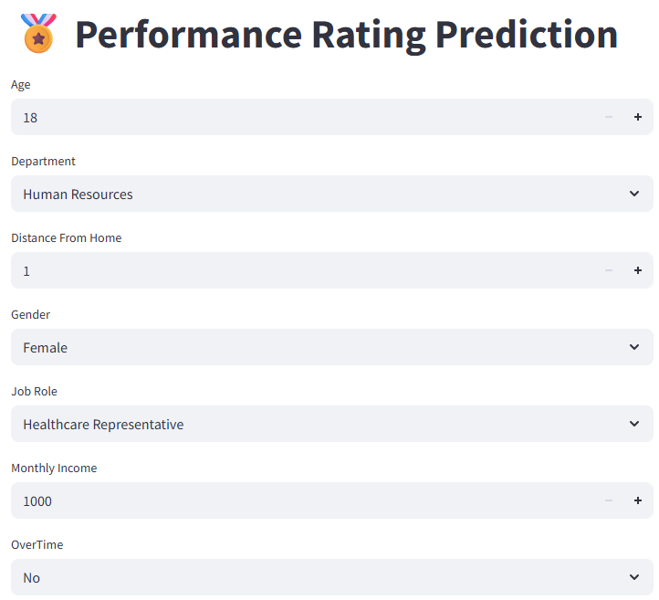

Slide 13
Model-Driven Insights :
The analysis reveals that attrition is not driven by single factor but by a combination of many factors
Compensation, workload and experiences are the primary contributors to employee attrition
Employees with lower monthly income, high over time demands and specific career stage characteristics are more likely to leave organisation
Additionally, Age, total working years reflect career stage effect, employees with certain level of experience levels are more likely to consider job change
Overtime and distance from home further emphasize the role of work life balance and commuting stress in attrition decision

Slide 14
Business TAKEAWAYS :
Regular salary reviews for employee with lower salary income can reduce attrition risk
Optimizing workload and staffing can improve retention
Customized retention strategies should target early- and mid-career employees
Fair and transparent pay structures may improve employee satisfaction
Providing company arranged cab or transportation allowance for employee living far from the workplace can reduce commute stress and improve punctuality
Trigger early interventions such as role changes, incentives or flexible work options can reduce risk of attrition

Slide 15


